Slide 1


cloud.iO Technical Presentation
Lucas Bonvin

Slide 2
Quick Reminder of cloud.iO

Slide 3

cloud.iO environment
Endpoint
Endpoint
Endpoint

Slide 4
Endpoint structure
MQTT
Endpoint
bc0f1bf8-bdae-11e9-9cb5-2a2ae2dbcce4
*
Node
bc0f1bf8-bdae-11e9-9cb5-2a2ae2dbcce4/myHeater
*
Object
*
bc0f1bf8-bdae-11e9-9cb5-2a2ae2dbcce4/myHeater/temperatures
*
Attribute
bc0f1bf8-bdae-11e9-9cb5-2a2ae2dbcce4/myHeater/temperatures/temperature

Slide 5
Topic / Json Object model
EndpointUUID: bc0f1bf8-bdae-11e9-9cb5-2a2ae2dbcce4
{
"endpointUuid": "bc0f1bf8-bdae-11e9-9cb5-2a2ae2dbcce4",
"friendlyName": "test",
"logLevel": "ERROR",
"online": false
"blocked": false,
"endpoint": {
"nodes": {
"myHeater": {
"implements": [],
"objects": {
"temperatures": {
"attributes": {
"setPointTemperature": {
"constraint": "SetPoint",
"timestamp": -1.0,
"type": "Number",
"value": 21.0
},
"temperature": {
"constraint": "Measure",
"timestamp": 1575547591858.0,
"type": "Number",
"value": 25.000000762939507
}
},
"conforms": null,
"objects": {}
}
}
}
}
}
}
Topic: @update/ bc0f1bf8-bdae-11e9-9cb5-2a2ae2dbcce4 /myHeater/temperatures/temperature
{
„type“: „Number“,
„constraint“: „Measure“,
„timestamp“:1575547591859.0,
„value“: 25
}

Slide 6
cloud.iO Features & Example

Slide 7


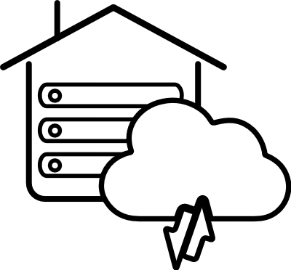




Device Monitoring
Endpoint Library
Open Source
On-premise
Deployment
RESTful API
W3C
Compatible
Logging
Remote jobs Execution

Slide 8
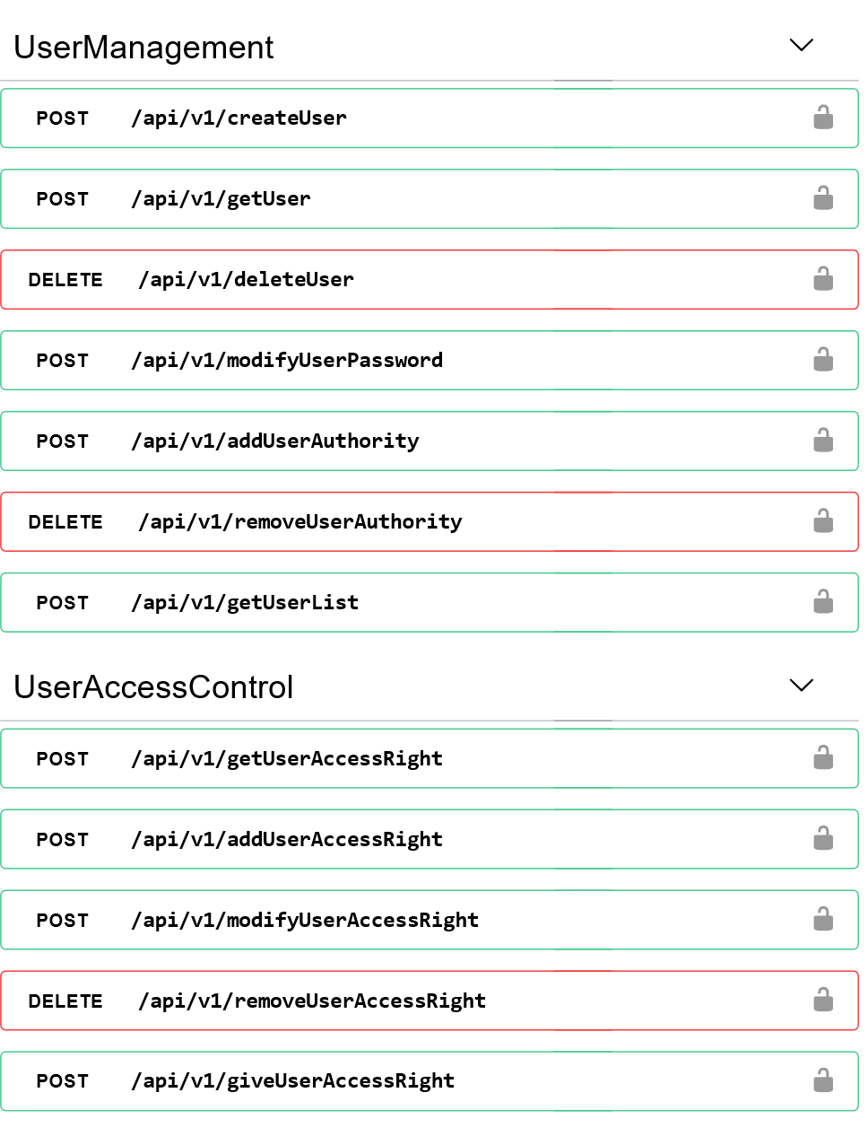

RESTful API
Http tools
User authentication
Support Https
Tools for User and Administrator
User & User Group Management
Endpoint Management
Certificate
History
Logging
Remote Jobs Execution
Available online
…

Slide 9

Device Monitoring
Access Control
Control who can access cloud.iO resources (From Endpoint to Attribute)
Endpoint Library
Send @update, receive @set
Concept of Transaction for low bandwidth Endpoint
Local Endpoint database
Locally saves messages not sent if the connection is lost
update
set
Endpoint

Slide 10
Device Monitoring
Access Control
Control who can access cloud.iO resources (From Endpoint to Attribute)
Endpoint Library
Send @update, receive @set
Concept of Transaction for low bandwidth Endpoint
Local Endpoint database
Locally saves messages not sent if the connection is lost
Endpoint
update

Slide 11
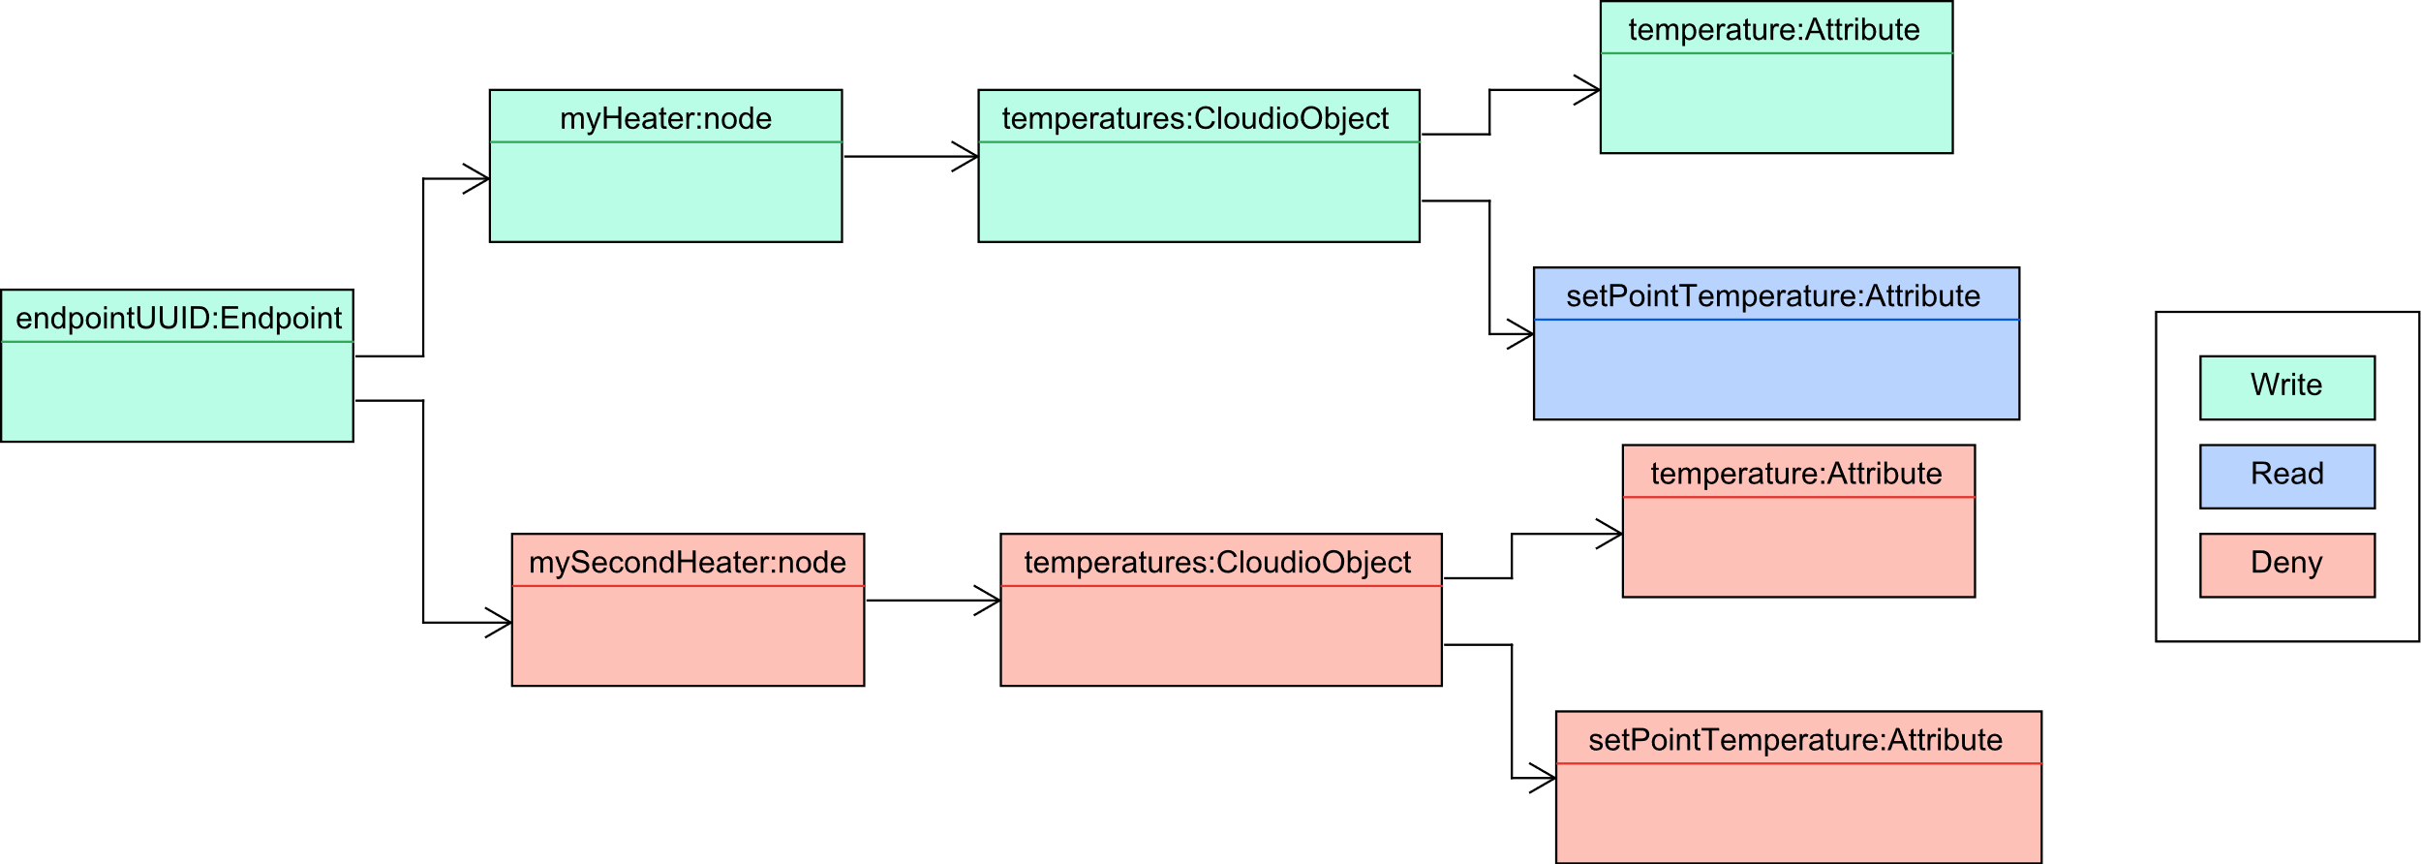
Device Monitoring – Access control (1)
Access right topic based for a User
{
"permissions": {
"endpointUUID/#": {
"permission": "WRITE",
"priority": "LOW"
},
"endpointUUID/mySecondHeater/#": {
"permission": "DENY",
"priority": "HIGH"
},
"endpointUUID/myHeater/temperatures/setPointTemperature": {
"permission": "READ",
"priority": "HIGHEST"
}
}
}

Slide 12
Device Monitoring – Access control (2)
Access control
User own created Endpoint
User and User Group
User can give access to its Endpoints to another User
User can give access to its Endpoints to a UserGroup
api/v1/giveUserAccessRight
{
"userName": "userB",
"userRights": [
{
"topic": "endpointUUID/#",
"permission": "GRANT",
"priority": "HIGHEST"
}
]
}
userB
userA
api/v1/ giveUserGroupAccessRight
{
"userGroupName": "userGroupA",
"userGroupRights": [
{
"topic": "endpointUUID/#",
"permission": "GRANT",
"priority": "HIGHEST"
}
]
}
userGroupA

Slide 13

Device Monitoring – Endpoint Library(1)
Java Example of simple Heater System
public class Application {
CloudioEndpoint myEndpoint;
DemoHeater demoHeater;
static Logger logger = LogManager.getLogger(Application.class);
public static void main(String[] args) {
try {
myEndpoint = new CloudioEndpoint("EndpointUUID");
myEndpoint.addNode("myHeater", DemoHeater.class);
demoHeater = myEndpoint.getNode("myHeater");
demoHeater.temperatures.setPointTemperature.addListener(
new CloudioAttributeListener() {
@Override public void attributeHasChanged
↳ (CloudioAttribute attribute) {
logger.trace("New Temperature set");
setSetPointTemperature((double)attribute.getValue());
}
});
while(true){
demoHeater.temperatures.temperature.setValue
↳ (retreiveAmbientTemperature());
Thread.sleep(1000);
}
} catch (Exception e) {
logger.error("Error In Application");
}
}
}
Endpoint Library
Listener for @set messages
@update messages send with setValue
Todo link github

Slide 14
Device Monitoring – Endpoint Library(2)
Java Example of Transaction
Transaction
Start with beginTransaction()
Send all updates in Transaction with commitTransaction()
Reset Transaction with rollbackTransaction()
public class Application {
static CloudioEndpoint myEndpoint;
public static void main(String[] args) {
myEndpoint = new CloudioEndpoint("endpointUUID");
//demoNode contains demoObject with demoStatus
//and demoMeasure
myEndpoint.addNode("demoNode", DemoNode.class);
DemoNode demoNode = myEndpoint.getNode("demoNode");
myEndpoint.beginTransaction();
//this setValue is forgotten by the transaction
//because of the rollback
demoNode.demoObject.demoStatus.setValue(20);
myEndpoint.rollbackTransaction();
demoNode.demoObject.demoStatus.setValue(20.0);
demoNode.demoObject.demoMeasure.setValue(20.0);
demoNode.demoObject.demoMeasure.setValue(21.0);
//only the second demoMeasure.setValue will
//be in the transaction
//demoStatus = 20.0 demMeasure = 21.0
myEndpoint.commitTransaction();
}
}
Todo link github

Slide 15
Logging
Logging
Saved as time-series
Possibility to filter by log level
Retrieve through RESTful API
Different log level
OFF
FATAL
ERROR
WARN
INFO
DEBUG
TRACE
ALL
!
Endpoint

Slide 16
Logging
Logging with Endpoint library
Use log4j library
Possibility to add log Appender
Logs send to depending Endpoint log level
Java Example of Log with log4j
import ...
import org.apache.logging.log4j.LogManager;
import org.apache.logging.log4j.Logger;
public class Application {
static CloudioEndpoint myEndpoint;
static Logger logger =
↳ LogManager.getLogger(Application.class);
static Logger rootLogger =
↳ LogManager.getRootLogger();
public static void main(String[] args) {
// create endpoint structure
myEndpoint = new CloudioEndpoint("endpointUUID");
...
//all the following logs will be pushed
//to the cloud according to Endpoint log level
logger.trace("This is a trace from Application logger");
rootLogger.trace("This is a trace from Root logger");
logger.error("Error log");
logger.debug("Debug log");
}
}

Slide 17
Remote Jobs Execution
Remote Jobs Execution
Execute Shell script remotely
Execution launched with MQTT or RESTful API
Possibility to retrieve output of script
Execute script.sh
script.sh
#!/bin/sh
echo Hello world !
Endpoint

Slide 18
Remote Jobs Execution
Remote Jobs Execution
Execute Shell script remotely
Execution launched with MQTT or RESTful API
Possibility to retrieve output of script
script.sh
#!/bin/sh
echo Hello world !
Output: Hello world!
Hello
world !
Endpoint

Slide 19
Remote Jobs Execution
Pre-implemented command
Listing all available commands/scripts
Update Scripts from an URL
Execution of Remote Jobs: Shell script
{
"endpointUuid": "bc0f1bf8-bdae-11e9-9cb5-2a2ae2dbcce4",
"jobURI": "file://script.sh",
"sendOutput": true,
"correlationID": "1a45a6ca",
"data": "",
"timeout": 5000,
}
{ "endpointUuid": "bc0f1bf8-bdae-11e9-9cb5-2a2ae2dbcce4",
"jobURI": "cmd://updateJobs",
"getOutput" : true,
"correlationID" : "fa8sf64j",
"timeout": 5000,
"data": "httesps://github.com/lucblender/
↳ downloadableFileTest/raw/master/ZipFile.zip"
}
Execution of Remote Jobs: Update script command

Slide 20
W3C compatibility
World Wide Web Consortium (W3C)
Standardization organism
Behind HTLM, RDF, CSS, PNG, SVG….
Standardization of the IoT
Web Of Thing (WoT)
Candidate Recommendation
Enhance IoT Interoperability
Define a data model for the Things :TD
TD contain a self-describing API
Thing
WoT Servient
Interact
Expose
TD Consumer
Consume
Application
WoT Servient

Slide 21
W3C compatibility (1)
Thing Description
Normalized device twin
Json-LD
Self describing API
Interaction Affordance (properties, actions, events)
Thing Description of Heater System without Interaction Affordance
{
"@context": "https://www.w3.org/2019/wot/td/v1",
"id": "urn:bc0f1bf8-bdae-11e9-9cb5-2a2ae2dbcce4:myHeater",
"title": "myHeater",
"securityDefinitions": {
"https_sc": {
"scheme": "basic",
"in": "query"
},
"mqtts_sc": {
"scheme": "cert"
}
},
"security": ["https_sc",
"mqtts_sc"],
...
}

Slide 22
W3C compatibility (2)
Property affordance of Heater System setpoint
Thing Description
Normalized device twin
Json-LD
Self describing API
Interaction Affordance (properties, actions, events)
{
...
"properties": {
...
"endpointUUID.myHeater.temperatures.setPointTemperature": {
"type": "object",
"properties": {
"constraint": {
"type": "string",
"enum": ["SetPoint"]
},
"type": {
"type": "string",
"enum": ["Integer"]
},
"timestamp": {
"type": "number"
},
"value": {
"type": "number"
}
},
"required": ["constraint", "type", "timestamp", "value"],
"forms": [{
"href": "https://cloud.iO:8081/api/v1/getAttribute/
↳endpointUUID.myHeater.temperatures.setPointTemperature",
"op": "readproperty",
"contentType": "application/json"
},
...
]}
},
...
}

Slide 23
cloud.iO Architecture

Slide 24



Overview
RabbitMQ
MQTT publish/subscribe
AMQP
Message broker
Microservices
AMQP
Backends
REST Controller
HTTP &
REST API
MQTT
publish/subscribe
Endpoints
User

Slide 25


Core messaging linked architecture
RabbitMQ
Spring services
Backend
#
MongoAuthService
"@online.*", "@offline.*",
"@nodeAdded.*.*", "@nodeRemoved.*
Type: Fanout
Value: auhentication
MongoLifecycleService
X
@logsLevel.*
MongoLogsService
Endpoint
@update.#, @set.#
InfluxUpdateSetService
Type: Topic
Value: amq.topic
"@online.*", "@offline.*",
"@nodeAdded.*.*", "@nodeRemoved.*
X
InfluxLifecycleService
@logs.*
InfluxLogsService
@execOutput.*, @exec.*
ExecJobsService
@transaction.*
EndpointTransactionService
@update messages

Slide 26


Core Rest linked Architecture
Spring MVC Security
Spring Rest Controller
Backend and RabbitMQ
UserManagementController
MongoCustomUserDetailsService
UserAccessControlController
SecurityConfiguration
UserGroupController
User
Port 8081
UserGroupAccessControlController
EndpointManagementController
CertificateController
@set messages
HistoryController
LogsController
@update messages
Type: Topic
Value: amq.topic
JobsController
X

Slide 27
Backends
Authentication / Permission
Endpoint Repository
History Repository
Logs Repository
MongoDB
Backend
InfluxDB
Backend

Slide 28
Open source
http://cloudio.hevs.ch
https://github.com/cloudio-project
cloudio-rabbitmq-docker
cloudio-services
cloudio-documents
cloudio-documentation
cloudio-endpoint-java
cloudio-endpoint-python
cloudio-grafana-plugin
cloudio-project.github.io

Slide 29
Questions?

